Slide 1
IISR Orientation Day 5
Personal Recommendations for Deep Learning Tools: PyTorch Lightning and Weights & Bias
蕭士凱 Nick
Notes:
Hi everyone, my name is Nick.
Today i’m going to share two useful tools for deep learning, including pytorch lightning and weights and bias, mainly on PyTorch Lightning though.
Ok, let’s begin.

Slide 2
Introduction

Slide 3
About Today’s Course
Today's session feels more like recommendations and sharing rather than a course.
The topic today is frameworks and tools, so the content will mainly consist of code. It should be relatively easier, but having some experience with PyTorch would make it more meaningful.
Since the main focus is on recommendations and sharing, we will only cover the basics and commonly used aspects, allowing everyone to gain a simple understanding. If you don't like it or choose not to use it, that's perfectly fine.
Additionally, we will briefly introduce some advanced training techniques and demonstrate how to use them in PyTorch Lightning.
Lastly, as always, we will have a practical implementation on Colab for everyone to try out.
Notes:
Before we dive into the course, I'd like to provide a brief introduction.
Today's session feels more like recommendations and sharing rather than a course.
The topic today is frameworks and tools, so the content will mainly consist of code. It should be relatively easier, but having some experience with PyTorch would make it more meaningful.
Since the main focus is on recommendations and sharing, we will only cover the basics and commonly used aspects, allowing everyone to gain a simple understanding. If you don't like it or choose not to use it, that's perfectly fine.
Additionally, we will briefly introduce some advanced training techniques and demonstrate how to use them in PyTorch Lightning.
Lastly, as always, we will have a practical implementation on Colab for everyone to try out.
Okay, let’s get in to it.

Slide 4

What is PyTorch Lightning?
PyTorch Lightning is an open-source Python deep learning framework built on top of PyTorch. It provides a high-level abstraction for PyTorch, simplifying the training and development of deep learning models.
Notes:
So, what is PyTorch Lightning?
It’s an open-source Python deep learning framework built on top of PyTorch.
It provides a high-level abstraction for PyTorch, simplifying the training and development of deep learning models.
Just like Keras is to TensorFlow, but I believe PyTorch Lightning is even more powerful than Keras.

Slide 5
Why PyTorch Lightning?
Clear Structure, Easy Maintenance: Provides a unified model structure that separates different parts of the training process, making code more readable and maintainable
Automated Training Loop: Automates the training loop, including data loading, optimizer setup, and gradient updates, reducing repetitive code and allowing you to focus on the model itself
Distributed Training: Built-in support for distributed training, enabling easy training on multiple GPUs or machines
Automated Logging and Monitoring: Automatically handle logging and visualization of training metrics, supporting popular monitoring tools
Simplified Tasks: Built-in callbacks for common task such as early stopping
In summary, PyTorch Lightning significantly simplifies the PyTorch model training process, allowing you to focus more on model development and improvement, while improving efficiency and reducing redundant code.
Notes:
So why should we use PyTorch Lightning? Is using PyTorch directly not a good option?
Sure, using plain PyTorch is entirely viable. However, PyTorch Lightning offers additional abstractions and features that make training and managing deep learning models easier for you.
Specifically, it has the following advantages:
Clear Structure, Easy Maintenance: Provides a unified model structure that separates different parts of the training process, making code more readable and maintainable
Automated Training Loop: Automates the training loop, including data loading, optimizer setup, and gradient updates, reducing repetitive code and allowing you to focus on the model itself
Distributed Training: Built-in support for distributed training, enabling easy training on multiple GPUs or machines
Automated Logging and Monitoring: Automatically handle logging and visualization of training metrics, supporting popular monitoring tools
Simplified Tasks: Built-in callbacks for common task such as early stopping
In summary, PyTorch Lightning significantly simplifies the PyTorch model training process, allowing you to focus more on model development and improvement, while improving efficiency and reducing redundant code.

Slide 6


By The Way
The famous text-to-image diffusion model, Stable Diffusion also uses PyTorch Lightning in its codebase.
Notes:
By the way, The famous text-to-image diffusion model, Stable Diffusion also uses PyTorch Lightning in its codebase.
And it was during my exploration of its source code that I first discovered the PyTorch Lightning framework.

Slide 7
Basic Usage of PL

Slide 8
Plain PyTorch
from torch import nn
class AutoEncoder(nn.Module):
def __init__(self):
super().__init__()
self.encoder = nn.Sequential(
nn.Linear(28 * 28, 64),
nn.ReLU(),
nn.Linear(64, 3)
)
self.decoder = nn.Sequential(
nn.Linear(3, 64),
nn.ReLU(),
nn.Linear(64, 28 * 28)
)
def forward(self, x):
x = x.view(x.size(0), -1)
z = self.encoder(x)
x_hat = self.decoder(z)
return x, x_hat
model = AutoEncoder()
model.to(device)
optimizer = torch.optim.Adam(model.parameters())
model.train()
for epoch in range(num_epochs):
for x, y in dataloader:
x = x.to(device)
x, x_hat = model(x)
loss = F.mse_loss(x_hat, x)
optimizer.zero_grad()
loss.backward()
optimizer.step()
Notes:
When writing a plain PyTorch training script, we typically do it like this.
First, on the left-hand side, in the constructor, we define the model architecture, and then in the forward method, we define how the model's parameters are passed.
Moving to the right-hand side, each time we often find ourselves repeatedly writing some cumbersome code, such as the training loop, moving tensors to the device, model.train() calls, and so on.
Moreover, these logics are scattered outside the model class, which makes the development process less efficient and harder to maintain.

Slide 9
PyTorch Lightning
import lightning as L
class LitAutoEncoder(L.LightningModule):
def __init__(self):
# Same as plain PyTorch
. . .
def training_step(self, batch, batch_idx):
x, y = batch
x = x.view(x.size(0), -1)
z = self.encoder(x)
x_hat = self.decoder(z)
loss = F.mse_loss(x_hat, x)
return loss
def configure_optimizers(self):
return torch.optim.Adam(self.parameters())
model = LitAutoEncoder()
trainer = L.Trainer(
accelerator='gpu',
max_epochs=num_epochs
)
trainer.fit(model, dataloader)
Notes:
And in PyTorch Lightning, we only need to have our model class inherit from `LightningModule`, and then override the `training_step` and `configure_optimizers` methods, returning the necessary elements.
As seen on the left-hand side, in `training_step`, this method is called for each training step and is passed a batch of data. We only need to ensure that this method returns the loss.
And `configure_optimizers`, is used to set up the optimizer. You just need to make sure it returns an optimizer object. However, this method has more capabilities, and if you're interested, you can explore further in the documentation.
Additionally, it's worth noting that `LightningModule` is a subclass of `nn.Module`, so it inherits all the functionalities that `nn.Module` has.
Moving to the right-hand side, you can see that you no longer need to write the training loop or handle optimizer updates yourself. Instead, you simply use the `Trainer` class and call `trainer.fit`.

Slide 10

Notes:
Now, let's take a look at a GIF that will demonstrate more clearly how to migrate from Plain PyTorch to PyTorch Lightning.

Slide 11
PL automates many things
Epoch and batch iteration
model.to(device), data.to(device)
optimizer.step(), loss.backward(), optimizer.zero_grad() calls
Calling of model.train(), model.eval() and enabling / disabling grads during evaluation
Checkpointing
Logging (track and visualize experiments)
Distributed Training
Mixed Precision Training
. . .
Notes:
Through the earlier demonstration, we can observe that PyTorch Lightning automates many tasks, such as epoch and batch iteration, moving tensors to devices, optimizer calls, and more.
However, in fact, it can automate even more tasks, including saving checkpoints, logging metrics, distributed training, mixed precision, and more.

Slide 12
More Basic Usage of PL
Notes:
Let's take a look at more use cases.

Slide 13
Logging / Tracking Metrics
class LitAutoEncoder(L.LightningModule):
. . .
def training_step(self, batch, batch_idx):
x, y = batch
x = x.view(x.size(0), -1)
z = self.encoder(x)
x_hat = self.decoder(z)
loss = F.mse_loss(x_hat, x)
self.log('Loss/Train', loss)
return loss
To track a metric, simply use the self.log() API inside LightningModule.
self.log() is designed to work with different logging backends seamlessly. By default, PL will log these metrics to the TensorBoard, however PL supports various backends which are called Loggers in PL, such as CSV, TensorBoard, WandB and more.
To use a specific logger, you need to create an instance of the logger and pass it to the Trainer constructor.
LightningModule.log
name (str) – key to log.
value (Union[Metric, Tensor, int, float]) – value to log. Can be a float, Tensor, or a Metric.
. . .
from lightning.pytorch.loggers import TensorBoardLogger
L.Trainer(logger=TensorBoardLogger())
Notes:
To track a metric, simply use the self.log() API inside LightningModule.
You only need to pass the name and value of the metric.
Furthermore, self.log() is designed to work with different logging backends seamlessly.
By default, PL will log these metrics to the TensorBoard, however PL supports various backends which are called Loggers in PL, such as CSV, TensorBoard, WandB and more.
To use a specific logger, you need to create an instance of the logger and pass it to the Trainer constructor.

Slide 14
Validating / Testing the model
class LitAutoEncoder(L.LightningModule):
def training_step(self, batch, batch_idx):
...
def validation_step(self, batch, batch_idx):
x, y = batch
x = x.view(x.size(0), -1)
z = self.encoder(x)
x_hat = self.decoder(z)
val_loss = F.mse_loss(x_hat, x)
self.log('Loss/Val', val_loss)
def test_step(self, batch, batch_idx):
...
model = LitAutoEncoder()
trainer = L.Trainer(
val_check_interval=1000,
check_val_every_n_epoch=1
)
trainer.fit(
model,
train_dataloaders=train_dataloader,
val_dataloaders=val_dataloader
)
trainer.test(model, test_dataloader)
Notes:
If you want to add logic for validating or testing the model, you only need to override validation_step or test_step, and provide the respective dataloader to the trainer.
Their usage is similar to training_step, so I won't elaborate further here.
Additionally, you can configure some parameters in the trainer to control the frequency of validation and more.

Slide 15
Early Stopping
lightning.pytorch.callbacks.EarlyStopping
monitor (str) – quantity to be monitored.
min_delta (float) – minimum change in the monitored quantity to qualify as an improvement.
patience (int) – number of checks with no improvement after which training will be stopped.
mode (str) – one of 'min', 'max'. In 'min' mode, training will stop when the quantity monitored has stopped decreasing and in 'max' mode it will stop when the quantity monitored has stopped increasing.
. . .
early_stopping = EarlyStopping(
monitor='Loss/Val',
min_delta=0.0,
patience=3,
mode='min'
)
trainer = L.Trainer(callbacks=[early_stopping])
trainer.fit(model, train_dataloader, val_dataloader)
Notes:
Early Stopping is a common technique used to prevent overfitting in machine learning models. In PyTorch Lightning, there is a built-in API for EarlyStopping, implemented using callbacks. To use it, we need to pass an EarlyStopping object to the callbacks parameter of the Trainer.
Let's briefly introduce some commonly used parameters:
monitor specifies which metric to monitor for triggering Early Stopping. Here, we've specified validation loss.
and min_delta is the minimum change in the monitored quantity to qualify as an improvement.
and patience is the number of checks with no improvement after which training will be stopped.
and mode, it can take values 'min' or 'max'. 'min' indicates that the monitored quantity should be minimized, and 'max' indicates it should be maximized.

Slide 16
Checkpointing (1)
By default, PL automatically save checkpoint on last training epoch
Unlike plain PyTorch, PL saves everything you need to restore a model
Current epoch / Global step
LightningModule’s state_dict
State of all optimizers, lr schedulers, callbacks
The hyperparameters (init arguments) with which the model was created
. . .
To load a LightningModule along with its weights and hyperparameters
MyLightningModule.load_from_checkpoint('/path/to/checkpoint.ckpt')
You can also save the checkpoint manually model = LitAutoEncoder()
trainer.fit(model)
trainer.save_checkpoint('/path/to/checkpoint.ckpt')
Notes:
Next, let’s talk about checkpointing
By default, PyTorch Lightning automatically saves a checkpoint at the end of the last training epoch.
Unlike plain PyTorch, PL stores all the necessary states for resuming the training process.
To load a checkpoint, you can simply call load_from_checkpoint, which will automatically load hyperparameters and model weights.
Additionally, you can use trainer.save_checkpoint to manually save a checkpoint if needed.

Slide 17
Checkpointing (2)
Save Hyperparameters
class MyLightningModule(L.LightningModule):
def __init__(self, learning_rate, another_parameter):
super().__init__()
self.save_hyperparameters()
checkpoint = torch.load('/path/to/checkpoint.ckpt') print(checkpoint['hyper_parameters'])
# {"learning_rate": the_value, "another_parameter": the_other_value}
Resume training state model = LitAutoEncoder() trainer = L.Trainer() # automatically restores model, epoch, step, LR schedulers, etc… trainer.fit(model, ckpt_path='/path/to/checkpoint.ckpt')
Notes:
Next, let's take a look at how to save hyperparameters.
Hyperparameters are essentially the parameters of the constructor. You can easily save them by calling self.save_hyperparameters(). This will store these parameters for later use.
To restore the training state, you simply need to pass the path to the checkpoint when calling trainer.fit. This will allow you to resume training from the saved checkpoint.

Slide 18
Checkpointing (2)
trainer = L.Trainer(
callbacks=[..., checkpoint_callback]
)
lightning.pytorch.callbacks.ModelCheckpoint
monitor (Optional[str]) – quantity to monitor. By default it is None which saves a checkpoint only for the last epoch.
save_top_k (int) – if save_top_k == k, the best k models according to the quantity monitored will be saved. if save_top_k == 0, no models are saved. if save_top_k == -1, all models are saved.
mode (str) – one of {min, max}. If save_top_k != 0, the decision to overwrite the current save file is made based on either the maximization or the minimization of the monitored quantity.
. . .
checkpoint_callback = ModelCheckpoint(
save_top_k=10,
monitor='Loss/Val',
mode='min',
auto_insert_metric_name=False,
filename='{epoch:02d}-{Loss/Val:.2f}',
)
checkpoint_callback = ModelCheckpoint(
monitor='global_step',
mode='max',
save_top_k=-1,
every_n_train_steps=500,
filename='{epoch:02d}-{global_step}'
)
Notes:
If you want to control a more complex checkpointing mechanism, you can use the ModelCheckpoint API. Like other functionalities, it's implemented as a callback, so you also need to pass it to the Trainer's callbacks parameter.
Its parameters monitor and mode are the same as in the previous EarlyStopping explanation, so I won't repeat them here.
The parameter save_top_k specifies how many of the top checkpoints to save. If set to -1, it saves all checkpoints.
Setting auto_insert_metric_name to False prevents PL from automatically adding the monitor metric's name to the checkpoint filenames.
You can also specify the filename to customize the filename, and it supports string templates for more flexibility.

Slide 19
Advanced Training Techniques

Slide 20
Gradient Accumulation & Gradient Clipping (1)
Gradient accumulation is a technique to mitigate memory constraints when training large models with limited GPU memory. It allows you to simulate using a larger effective batch size without increasing the actual batch size.
Gradient clipping is a technique to limit the magnitude of gradients during backpropagation, preventing exploding gradients and stabilizing training.
Notes:
Here we talk about two commonly used tricks for training, first is Gradient accumulation
It’s a technique to mitigate memory constraints when training large models with limited GPU memory.
It allows you to simulate using a larger effective batch size without increasing the actual batch size.
And second is Gradient clipping
It’s a technique to limit the magnitude of gradients during backpropagation, preventing exploding gradients and stabilizing training.

Slide 21
Gradient Accumulation & Gradient Clipping (2)
# Plain PyTorch ...
gradient_clip_algorithm = 'norm' # or value
gradient_clip_val = 1.0
gradient_accumulate_steps = 4
for batch_idx, batch in enumerate(dataloader):
...
loss = loss / gradient_accumulate_steps
loss.backward()
if (batch_idx + 1) % gradient_accumulate_steps == 0:
if gradient_clip_algorithm == 'norm':
torch.nn.utils.clip_grad_norm_(model.parameters(), gradient_clip_val)
elif gradient_clip_algorithm == 'value':
torch.nn.utils.clip_grad_value_(model.parameters(), gradient_clip_val)
optimizer.step()
optimizer.zero_grad()
# PyTorch Lightning L.Trainer(
gradient_accumulate_steps=4,
gradient_clip_algorithm='norm', # Default
gradient_clip_val=1.0
)
Notes:
In plain PyTorch, implementing these two functionalities would require inserting additional code into the training loop. However, in PyTorch Lightning (PL), you only need to pass parameters to the Trainer to achieve the same functionalities.

Slide 22
Mixed Precision Training (1)
PyTorch trains on 32-bit floating-point (FP32) arithmetic by default. However, many deep learning models do not require this to reach complete accuracy.
In such cases, using lower-precision arithmetic like 16-bit floating-point (FP16) can offer several advantages. The key advantages are:
Faster Computation: Half precision uses 16 bits to represent numbers compared to 32 bits in single precision (FP32). This means that FP16 operations can be performed with lower memory bandwidth and storage requirements, leading to faster computation times.
Reduced Memory Usage: Since half precision requires half the memory compared to single precision, it allows for larger model architectures and batch sizes without running into memory limitations.
Notes:
PyTorch trains on 32-bit floating-point (FP32) arithmetic by default. However, many deep learning models do not require this to reach complete accuracy.
In such cases, using lower-precision arithmetic like 16-bit floating-point (FP16) can offer several advantages. The key advantages are:
Faster Computation: Half precision uses 16 bits to represent numbers compared to 32 bits in single precision (FP32). This means that FP16 operations can be performed with lower memory bandwidth and storage requirements, leading to faster computation times.
Reduced Memory Usage: Since half precision requires half the memory compared to single precision, it allows for larger model architectures and batch sizes without running into memory limitations.

Slide 23
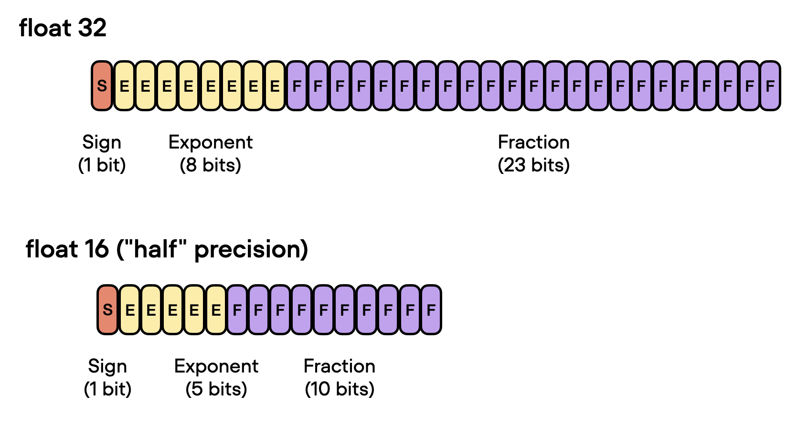
Mixed Precision Training (2) - Why “Mixed”?
Compared to FP32, which has 8 exponent bits, FP16 has only 5 exponent bits, resulting in a significantly narrower dynamic range. As a result, if the values are too large or too small, it can lead to overflow or underflow issues, causing instability in model training. To alleviate this issue, we can keep precision-sensitive computations in FP32 while using FP16 for computations that are not as sensitive, and this is the concept of mixed precision training.
Notes:
But why “mixed” precision training? Why not something like pure FP16 training?
To explain why, we need to know that compared to FP32, which has 8 exponent bits, FP16 has only 5 exponent bits, resulting in a significantly narrower dynamic range.
As a result, if the values are too large or too small, it can lead to overflow or underflow issues, causing instability in model training.
To alleviate this issue, we can keep precision-sensitive computations in FP32 while using FP16 for computations that are not as sensitive, and this is the concept of mixed precision training.

Slide 24
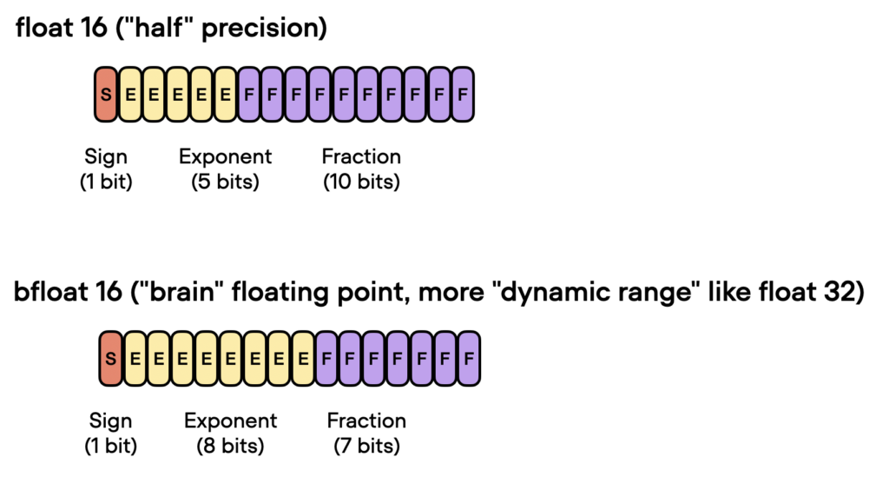
Mixed Precision Training (3)
To further alleviate the dynamic range issues of FP16, a new data type, BF16, has been introduced. BF16 employs a 8-bit exponent and a 7-bit fraction, striking a balance between the range of representable values and precision.
Notes:
To further alleviate the dynamic range issues of FP16, a new data type, BF16, has been introduced. BF16 employs a 8-bit exponent and a 7-bit fraction, striking a balance between the range of representable values and precision.

Slide 25
Mixed Precision Training (4)
# PL L.Trainer(
precision='16-mixed'
# 'bf16-mixed'
)
# Plain PyTorch
scaler = torch.cuda.amp.GradScaler()
for epoch in range(num_epochs):
for input, target in dataloader:
optimizer.zero_grad()
with torch.autocast(device_type='cuda', dtype=torch.float16):
output = model(x)
loss = loss_fn(output, target)
scaler.scale(loss).backward()
scaler.step(optimizer)
scaler.update()
Notes:
Just like the previous functionalities, mixed precision in PyTorch Lightning is also simplified.
Compared to plain PyTorch, you only need to pass parameters to the Trainer to enable mixed precision.

Slide 26
Distributed Training (1)
Distributed training is a technique to train large models more efficiently by distributing the computational workload across multiple devices or machines.
It involves parallelizing the training process by dividing the data and computations across multiple devices or machines. This can be done in several ways, including:
Data Parallelism
Tensor Parallelism
Pipeline Parallelism
…
To learn more about parallelization concepts, I recommend visiting this page.
Notes:
Distributed training is a technique to train large models more efficiently by distributing the computational workload across multiple devices or machines.
It involves parallelizing the training process by dividing the data and computations across multiple devices or machines. This can be done in several ways, including:
Data Parallelism
Tensor Parallelism
Pipeline Parallelism
and so on.
Here, I'll only provide a brief introduction to training strategies that are relevant to Data Parallelism.

Slide 27
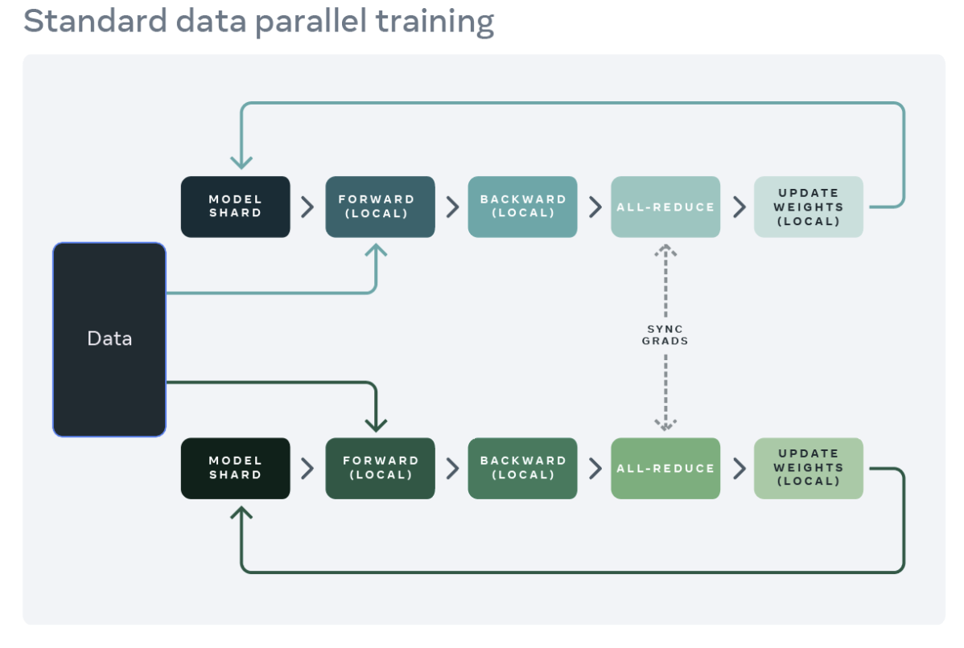
Distributed Training (2)
DDP(Distributed Data Parallel) replicates the model across each worker, and partitions the dataset across the workers. Different workers process different data partitions in parallel and synchronize their gradients before model weights are updated.
Notes:
DDP(Distributed Data Parallel) replicates the model across each worker, and partitions the dataset across the workers. Different workers process different data partitions in parallel and synchronize their gradients before model weights are updated.

Slide 28
Distributed Training (2)
Scaling a model with DDP can eventually result in out-of-memory issues when a single GPU’s memory becomes insufficient since it replicates the parameters, gradients, and optimizer states on all workers.
DeepSpeed ZeRO(Zero Redundancy Optimizer) & FSDP(Fully Sharded Data Parallel)
To reduce this replication and save GPU memory, we can shard the model parameters, gradients, and optimizer states across all workers with each worker only managing a single shard. During a forward and backward passes, we unshard the model parameters as needed for computation and reshard them after computation.
This technique was popularized by the ZeRO-3 approach developed by Microsoft. A PyTorch-native implementation of this approach is available as FSDP.
Notes:
Scaling a model with DDP can eventually result in out-of-memory issues when a single GPU’s memory becomes insufficient since it replicates the parameters, gradients, and optimizer states on all workers.
DeepSpeed ZeRO(Zero Redundancy Optimizer) & FSDP(Fully Sharded Data Parallel)
To reduce this replication and save GPU memory, we can shard the model parameters, gradients, and optimizer states across all workers with each worker only managing a single shard. During a forward and backward passes, we unshard the model parameters as needed for computation and reshard them after computation.
This technique was popularized by the ZeRO-3 approach developed by Microsoft. A PyTorch-native implementation of this approach is available as FSDP.

Slide 29
Distributed Training (3)
Distributed training in plain PyTorch can be cumbersome, let alone switching between different training strategies.
Therefore, we skip how to use distributed training in plain PyTorch and focus on how to use it in PL.
L.Trainer(
devices=8, # GPUs per node
num_nodes=4, # Number of nodes
strategy='ddp', # fsdp, deepspeed, ...
)
Notes:
Distributed training in plain PyTorch can be cumbersome, let alone switching between different training strategies.
Therefore, we skip how to use distributed training in plain PyTorch and focus on how to use it in PL.
Enabling distributed training in PyTorch Lightning is also straightforward.
You only need to pass the number of GPUs and nodes to the trainer.
Additionally, you can easily choose different training strategies by using the strategy parameter.

Slide 30
Weights & Bias

Slide 31
What is W&B ?
Weights & Biases is a platform that helps track and visualize machine learning experiments. It does this by:
Tracking: Logging details like settings and results from experiments.
Visualization: Creating graphs, images, and interactive displays.
Collaboration: Letting team members share and discuss results.
Versioning: Connecting specific code versions to experiments.
Reports: Generating and sharing experiment summaries.
To learn more about it, you can refer to the documentation.
Notes:
Weights & Biases is a platform that helps track and visualize machine learning experiments. It does this by:
Tracking: Logging details like settings and results from experiments.
Visualization: Creating graphs, images, and interactive displays.
Collaboration: Letting team members share and discuss results.
Versioning: Connecting specific code versions to experiments.
Reports: Generating and sharing experiment summaries.
Sadly, due to time constraints, I won't go into the detailed usage of W&B.
I'll just explain how to integrate it into PyTorch Lightning (PL).
You can explore it further during the Colab exercise. It should be quite straightforward to get started, and for more advanced usage, you can refer to the documentation.

Slide 32
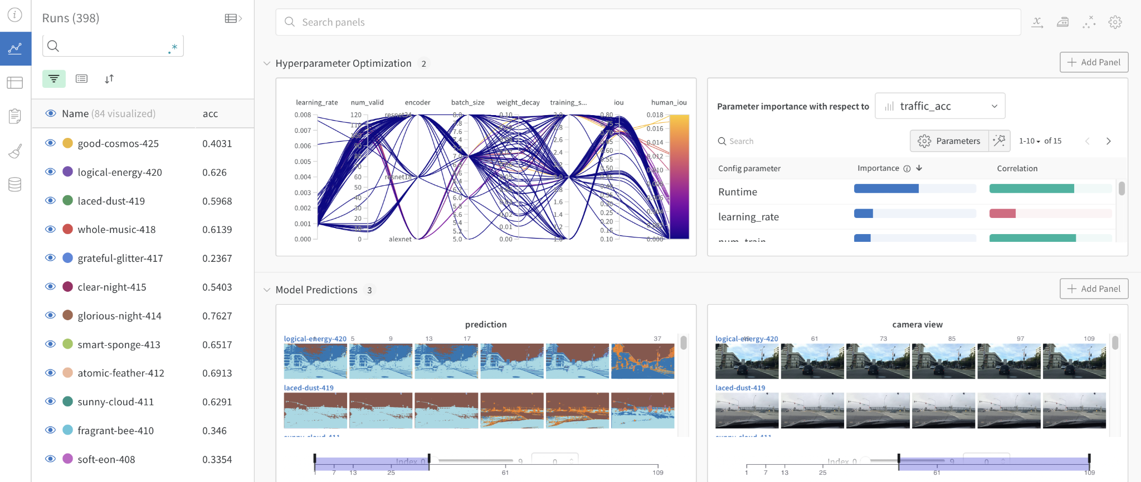
Notes:
Let’s take a look at a snapshot of the W&B user interface, it looks quite cool to me.

Slide 33
Use W&B with PL (1)
from lightning.pytorch.loggers import WandbLogger
L.Trainer(
logger=WandbLogger(
project='name_of_your_project',
name='name_of_your_run',
)
)
lightning.pytorch.loggers.WandbLogger
name (Optional[str]) – Display name for the run.
project (Optional[str]) – The name of the project to which this run will belong.
. . .
Notes:
If you want to use W&B in PyTorch Lightning, you just need to pass a WandbLogger object to the Trainer.

Slide 34
Use W&B with PL (2)
class MyLightningModule(L.LightningModule):
def validation_step(self, *args: Any, **kwargs: Any):
...
# Log metrics
self.log('metric_name', metric_value)
# Log images
self.logger.log_image(key='sample', images=[img1, img2])
# Log text
columns = ['input', 'label', 'prediction']
my_data = [['cheese', 'english', 'english'], ['fromage', 'french', 'spanish']]
self.logger.log_text(key='my_samples', columns=columns, data=my_data)
More information can be found here.
Notes:
And when you use self.log in your LightningModule, it will automatically log the information to W&B.
If you need to record specific data types like images, text, tables, etc., you can use self.logger to access the WandbLogger object, allowing you to access various APIs provided by W&B.

Slide 35
Any Questions?

Slide 36
Try it out on Colab
https://tiny.cc/iisr-112o-5
or
https://colab.research.google.com/drive/1-9u2QwvgLclGFL24ugkIPEBpGi5NqF-i

